Slide 1
Discussion Week 5
Transactions and wire diagrams

Slide 2
Transactions
Go on Eclipse

Slide 3
Wire Diagram : Model 1 programming
List the pages and how requests lead from calling pages to called pages
List request parameters
Take note of which requests may transfer to a called page (called.jsp)
Start called.jsp with scriptlet code that collects its request parameters, figures out what request was made and makes the appropriate side effects on session and the database

Slide 4
calling.jsp (or calling.html)
Simplest case:
The called.jsp is accessible via
a single calling.jsp
AND (simplifying assumption)
we do not care about the possibility
that the user may issue directly a call
http://.../called.jsp
<Form action=“called.jsp”>
n₁
p₁
n₂
p₂
…/app/called.jsp? n₁=p₁ n₂=p_{2 …}
called.jsp
Jsp scriptlet picks parameters p₁ p₂ … updating session & database
JSP expressions & scriptlets producing the html page

Slide 5
Wire Diagram
We have 3 pages :
Enter.html : The customer enters his username
Choose.jsp : The customer is greeted by his username and can choose to buy a pen or a pencil, and specify how many pens or pencils he wishes to buy.
Order.jsp : Once the customer chose what he wants, he proceeds to provide his credit card number.

Slide 6
Think of enter.html as being the calling.html
Think of choose.jsp as being the called.jsp
enter.html
choose.jsp
?product=…
&amount=…
order.jsp
…?user=…
Session

Slide 7
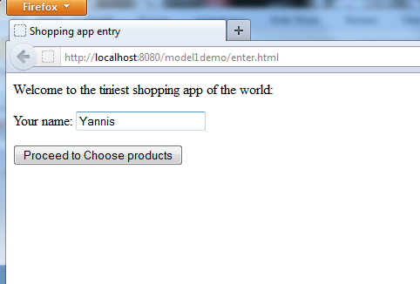
enter.html

Slide 8
enter.html
<html>
<head><title>Shopping app entry</title></head>
<body>
Welcome to the tiniest shopping app of the world:<p>
<form method="GET" action="choose.jsp">
Your name: <input type="text" size="20" name="user"/><p />
<input type="submit" value="Proceed to Choose products"/>
</form>
</body>
</html>

Slide 9
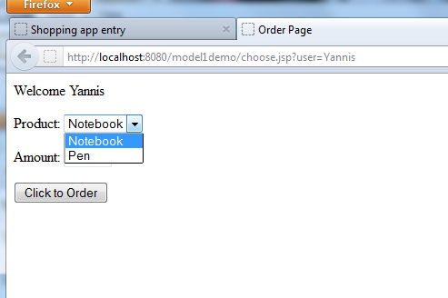
choose.jsp

Slide 10
Choose.jsp: Scriptlet book-keeps data received from “calling” page
<html>
<head><title>Order Page</title></head>
<body>
<%
String user = request.getParameter("user");
session.setAttribute("user", user);
%>
Welcome <%= user %> <p>
<form method="GET" action="order.jsp">
Product:
<select name="product">
<option value="Notebook">Notebook</option>
<option value="Pen">Pen</option>
</select>
<p>
Amount: <input type="text" size="4" name="amount"/><p />
<input type="submit" value="Click to Order"/>
</form>
</body>
</html>

Slide 11
Choose.jsp: … and then visualization part produces html
<html>
<head><title>Order Page</title></head>
<body>
<%
String user = request.getParameter("user");
session.setAttribute("user", user);
%>
Welcome <%= user %> <p>
<form method="GET" action="order.jsp">
Product:
<select name="product">
<option value="Notebook">Notebook</option>
<option value="Pen">Pen</option>
</select>
<p>
Amount: <input type="text" size="4" name="amount"/><p />
<input type="submit" value="Click to Order"/>
</form>
</body>
</html>

Slide 12
Now think of choose.jsp as being the calling.jsp
..and think of order.jsp as being the called.jsp
enter.html
choose.jsp
?product=…
&amount=…
order.jsp
…?user=…
Session

Slide 13
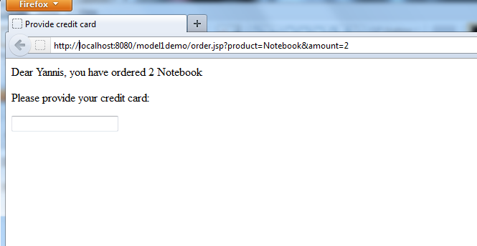

Slide 14
order.jsp: Again, first the scriptlet book keeps then the rest visualizes
<html>
<head> <title>Provide credit card</title> </head>
<body>
<%
String product = request.getParameter("product");
String amountAsString = request.getParameter("amount");
Integer amount = Integer.parseInt(amountAsString) ;
session.setAttribute("product", product);
session.setAttribute("amount", amount);
%>
Dear <%= session.getAttribute("user") %>,
you have ordered <%= session.getAttribute("amount") %>
<%= session.getAttribute("product") %> <p>
Please provide your credit card:<p>
<form method=“POST" action="dummyCreditCharge.jsp">
<input type="text" size"=16" name="credit"/>
</form>
</body>
</html>

Slide 15
Next case:
Two (or more) pages (or generally forms) transferring to the same called.jsp
AND for some reason you need to know which one called
calling2.jsp
…/app/called.jsp? action=type2&n’₁=p’₁&n’₂=p’_{2 …}
calling1.jsp
…/app/called.jsp? action=type1&n₁=p₁&n₂=p_{2 …}
called.jsp
String action=request.getParameter(“action”);
if (action!=null && action.equals(“type1”)) {
book-keep according to first request
}
if (action!=null && action.equals(“type2”)) {
book-keep according to second request
}
If (action==null or none of above) {
some error display code
}
Distinguish which of the two (or more) requests invoked the called.jsp
JSP expressions & scriptlets producing the html page

Slide 16
One of the calling pages may be the called.jsp (the original use of Model 1)
initcalling.jsp
called.jsp
Distinguish which of the two (or more) requests invoked the called.jsp
JSP expressions & scriptlets producing the html page

Slide 17
Handle multiple request types
Database accessing code
If request to insert student perform SQL INSERT
If request to delete student perform SQL UPDATE
If request to update student perform SQL DELETE
HTML-producing part of JSP
INSERT STUDENT FORM
UPDATE STUDENT FORMS
DELETE STUDENT FORMS
http://.../students.jsp?action=insert&...
http://.../students.jsp?action=update&...
http://.../students.jsp?action=delete&...

